Slide 1

SMALL INTESTINE ULCER CLASSIFICATION USING NARROW BAND IMAGING
Normal
Ulcerative_Colitis
Polyps
Esophagitis
NEURONEXUS

Slide 2
DATA DISTRIBUTION
TRAIN Data Distribution:
0_normal: 800 images
1_ulcerative_colitis: 800 images
2_polyps: 800 images
3_esophagitis: 800 images
VAL Data Distribution:
0_normal: 500 images
1_ulcerative_colitis: 500 images
2_polyps: 500 images
3_esophagitis: 500 images
TEST Data Distribution:
0_normal: 200 images
1_ulcerative_colitis: 200 images
2_polyps: 200 images
3_esophagitis: 200 images

Slide 3
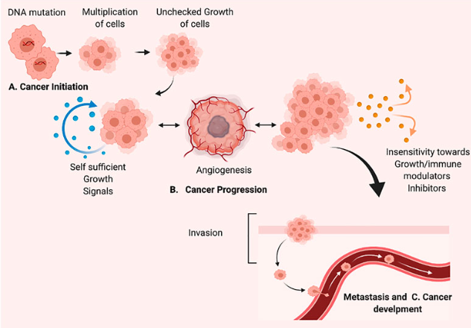
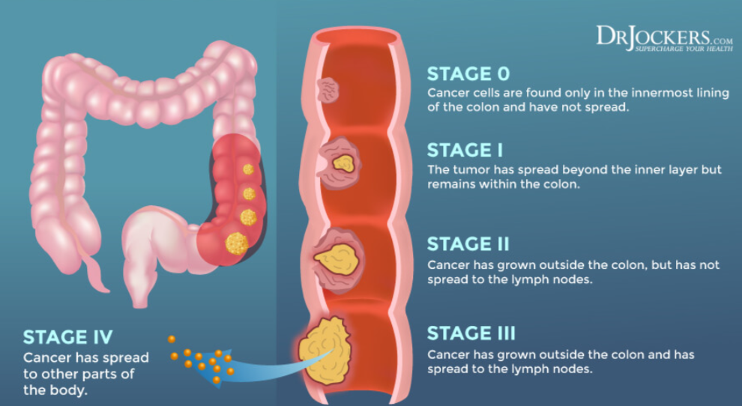
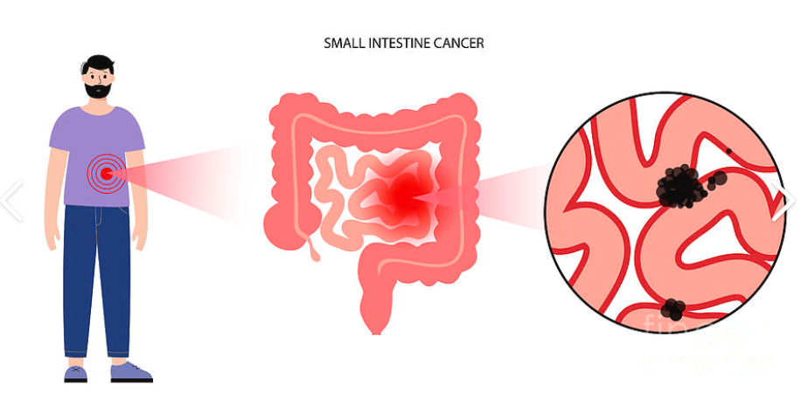

Slide 4
The color differences between Ulcerative Colitis (UC),
Polyps, and Esophagitis in medical images are as follows:
1. Ulcerative Colitis (UC)
Colors:
Red to deep red due to inflammation.
Pale or white ulcers (areas of tissue loss).
Dark red or maroon continuous patches due to bleeding.(no healthy tissue between inflamed regions).
2. Polyps
Colors:
Pink to reddish if normal and benign.
Darker red or brown if inflamed or bleeding.
Whitish or discolored if precancerous.
Can be benign or precancerous.
3. Esophagitis
Colors:
Bright red or deep red streaks due to irritation.
White or yellow patches in infections (like Candida esophagitis).
Dark brown or black areas in severe ulceration or necrosis.

Slide 5
Band Selection
630-690 nm (Red Band)Vascular and Tissue Differentiation :-
This band is useful for detecting deep tissue structures due to its ability to penetrate deeper into biological tissues.
It helps in identifying chronic inflammatory conditions such as ulcerative colitis, where tissue remodeling and increased vascularization occur.
It provides enhanced contrast for polyps and abnormal growths, as these structures often exhibit different blood supply patterns compared to normal tissue.
525-575 nm (Green Band) Hemoglobin and Oxygenation Level :-
This range is primarily absorbed by oxyhemoglobin and deoxyhemoglobin, making it useful for visualizing vascular structures in the small intestine.
It helps in differentiating normal tissue from inflamed or ulcerated areas, as inflammation leads to increased blood flow and changes in oxygen saturation.
Useful for detecting ulcerative colitis, where blood supply and tissue oxygenation are altered.

Slide 6
Band Selection
415-465 nm (Blue Band) Mucosal Surface and Tissue Absorption :-
This range is strongly absorbed by deoxyhemoglobin, making it effective for detecting early-stage tissue abnormalities.
It enhances contrast in esophageal and intestinal lesions, aiding in the detection of esophagitis and initial ulcerative changes.
Blue light penetrates less deeply than red or infrared, allowing clear visualization of surface-level epithelial damage in conditions like polyps and early-stage ulcers.
Research Paper :-
Use of Hyperspectral/Multispectral imaging in gastroenterology
-Samuel Ortega,Himar Fabelo,Gustavo Callico

Slide 7
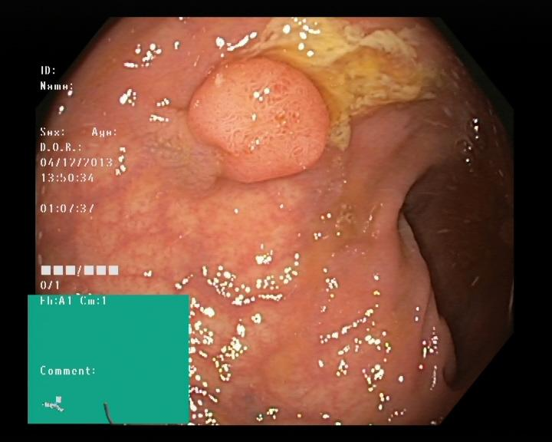
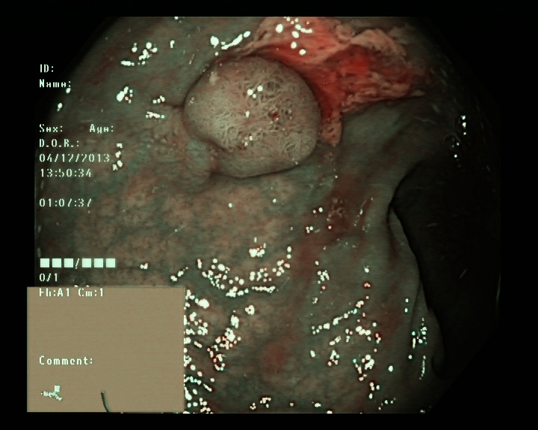
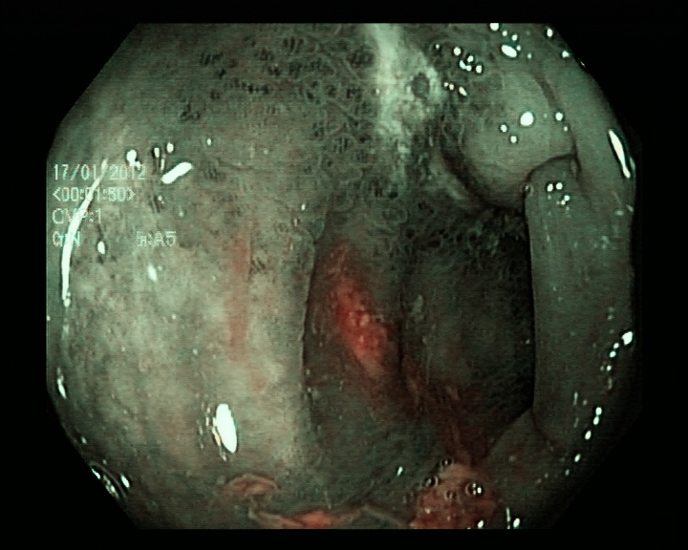
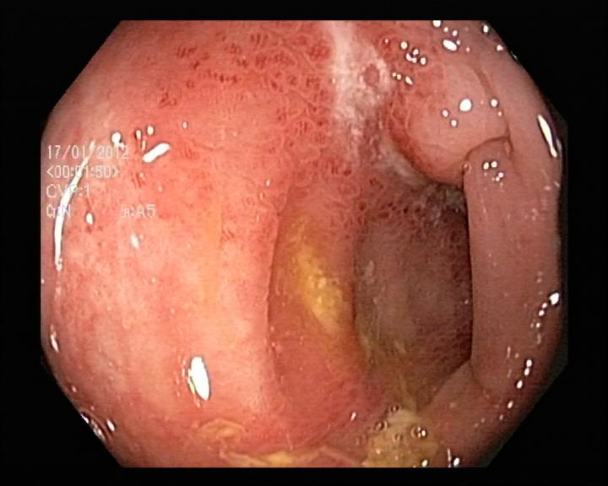
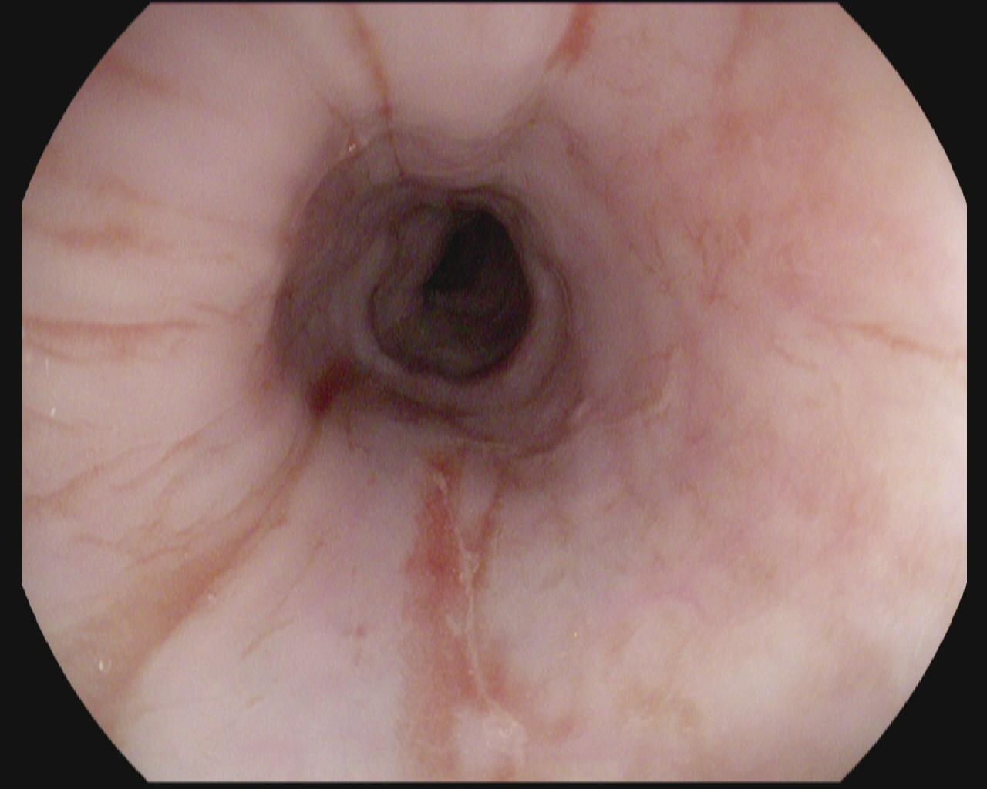
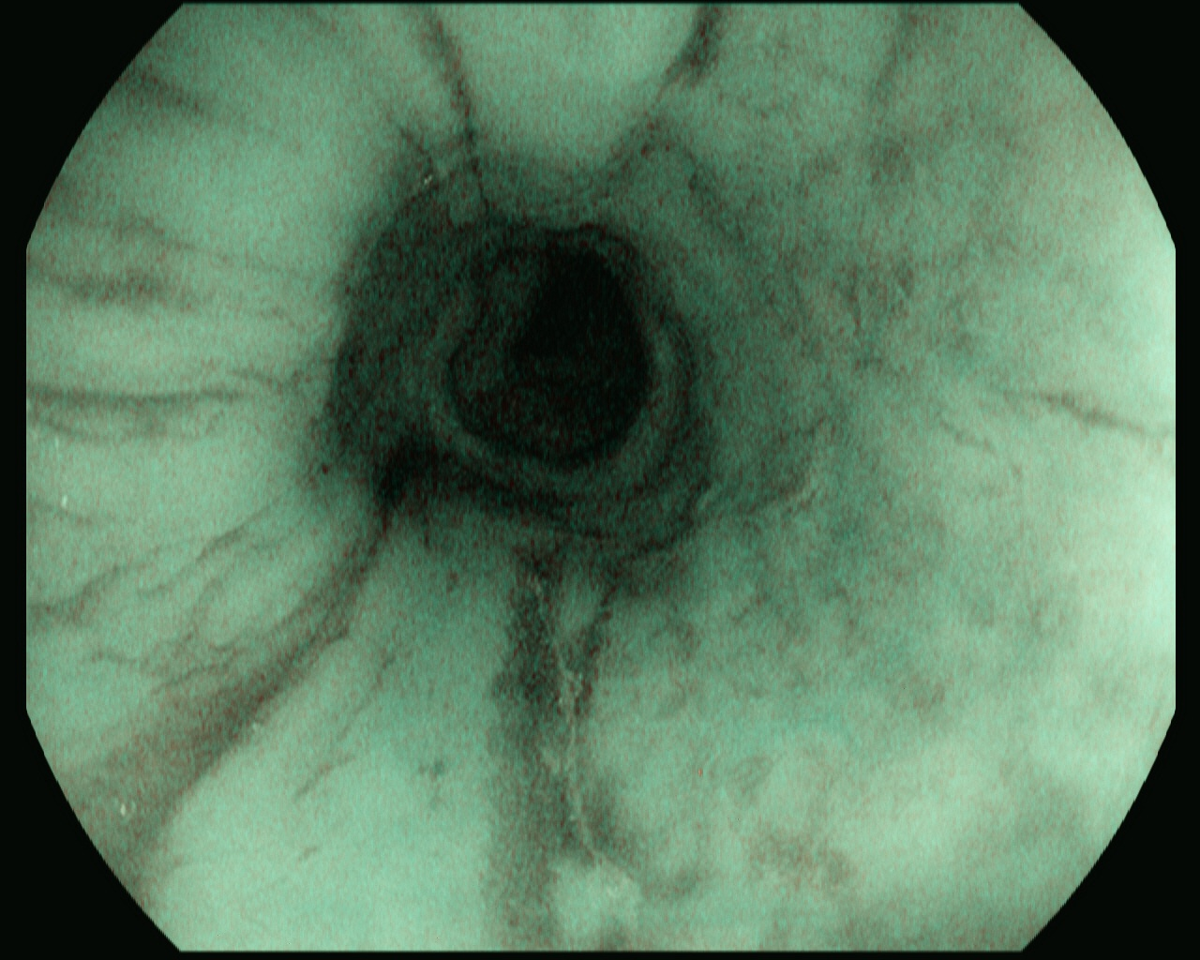
Raw Images
NBI Images
Polyps
Polyps
Ulcerative_Colitis
Ulcerative_Colitis
Esophagitis
Esophagitis

Slide 8
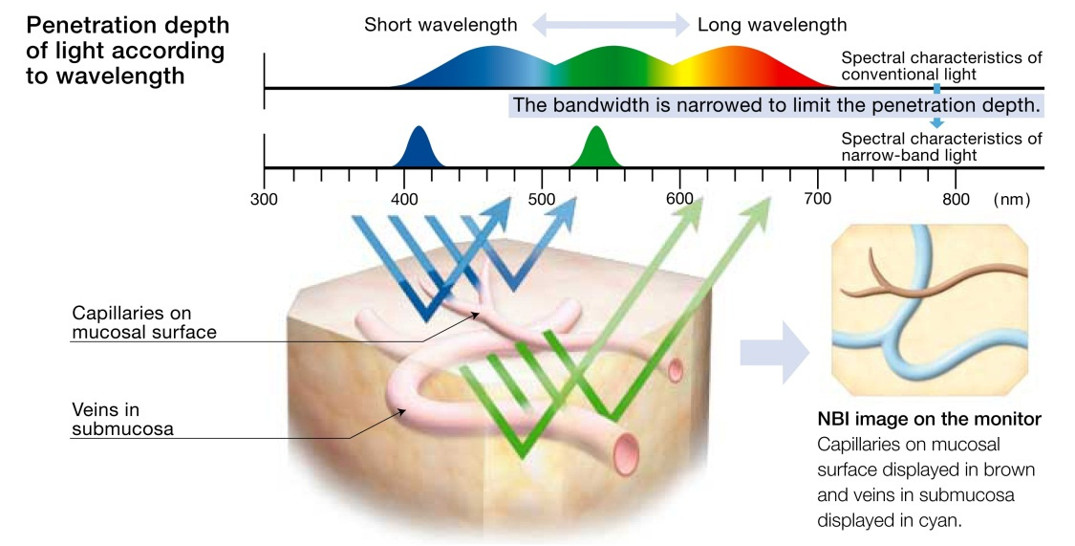
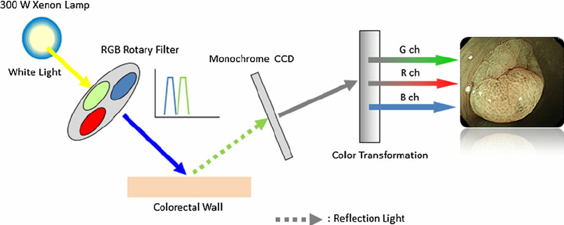
What is NB Imaging ?

Slide 9
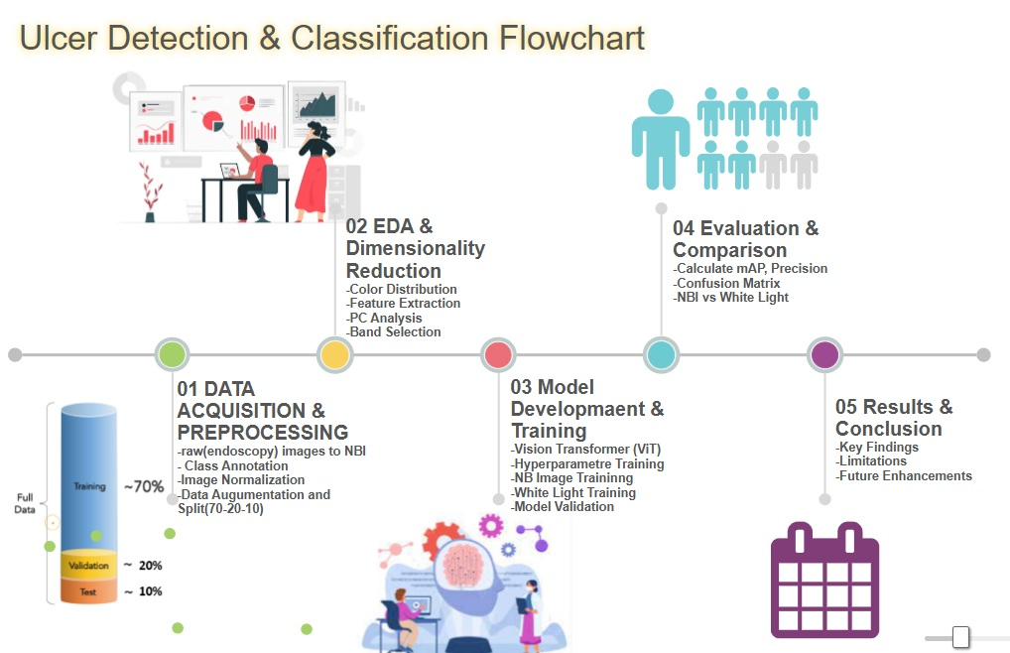

Slide 10
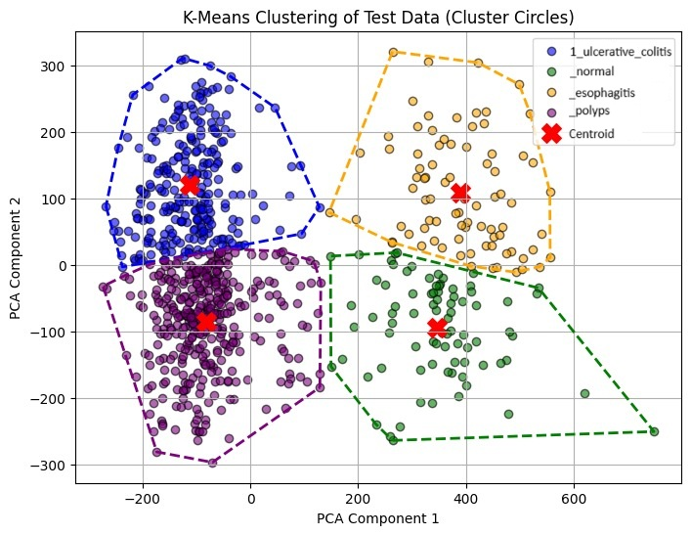
PCA(PRINCIPAL COMPONENT ANALYSIS)

Slide 11
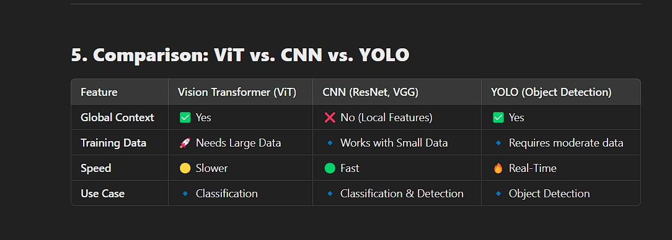
CLASSIFICATION MODEL : COMPARISON

Slide 12
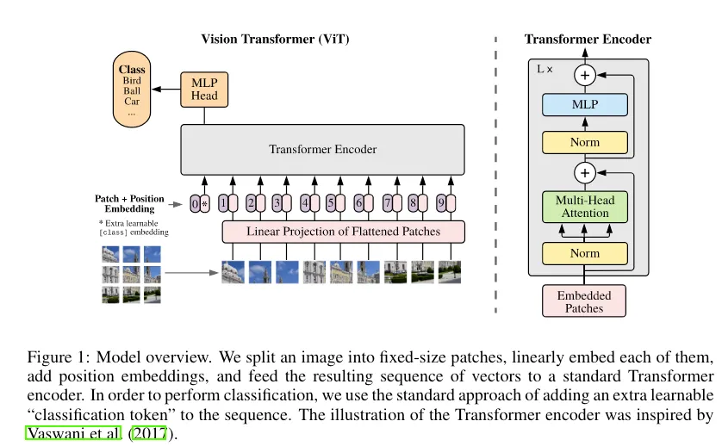
CLASSIFICATION MODEL : ViT

Slide 13
CLASSIFICATION MODEL (VIT)
ViT Architecture
The ViT model follows this structure:
Patch Embedding Layer – Converts an image into patch sequences.
Position Embeddings – Adds location-based information.
Multiple Transformer Layers – Processes the patch sequences using self-attention.
Classification Token – Aggregates features for final classification.

Slide 14
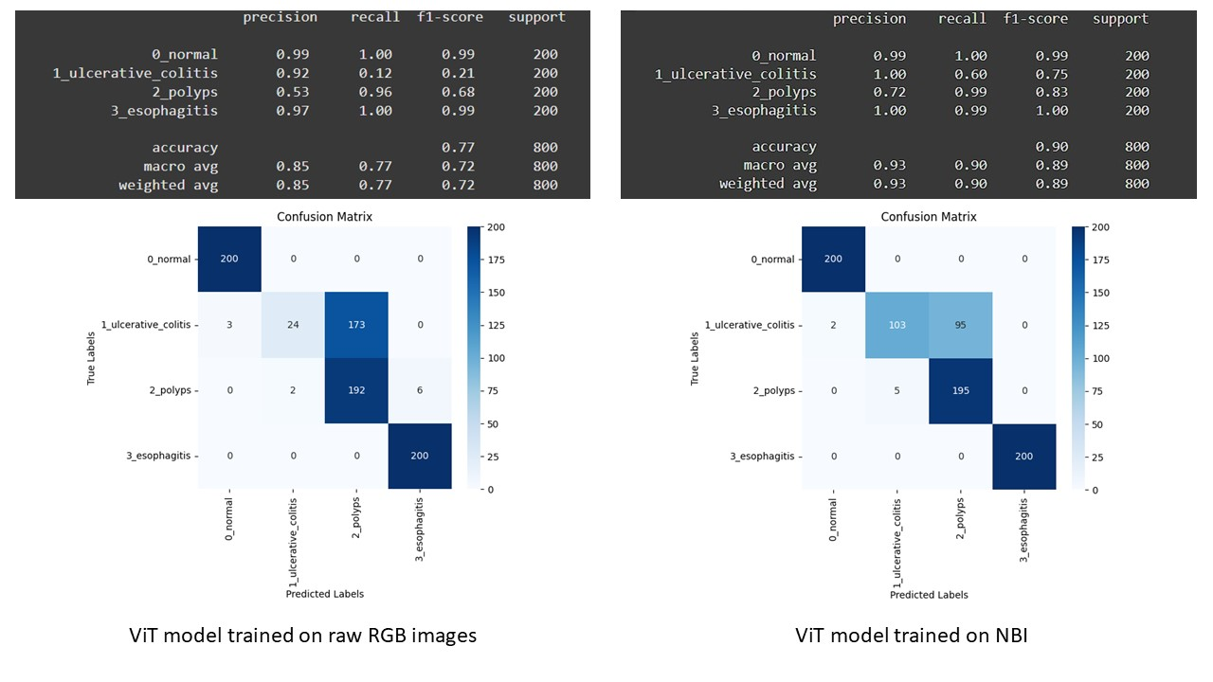
OBSERVATION (White light vs NBI)

Slide 15
OBSERVATION (White light vs NBI)
NBI model outperforms White Light model (90% vs. 77% accuracy).
Ulcerative colitis detection improves significantly with NBI (60% recall vs. 12% in White Light).
Better separation between ulcerative colitis and polyps in NBI model.
Lower misclassification rate in NBI, making it more reliable.
NBI enhances feature visibility, leading to improved classification.

Slide 16
FUTURE SCOPE
Enhanced Region-Specific Prediction
Incorporating anatomical data, such as the duodenum and valve regions of the intestine,which are more prone to stomach acid exposure have a higher risk of ulcer formation and cancer development.
2. Personalized Risk Prediction
By incorporating patient history, genetic markers, and lifestyle factors into the model,
we can enhance personalized risk prediction,leading to better preventive care and
early screening recommendations.
3. Real-Time Endoscopic Assistance
Implementing AI-driven real-time analysis in endoscopic procedures can help doctors
receive instant feedback on suspicious tissue regions

Slide 17
Conclusion
ViT performs well in classification but requires large datasets for optimal results.
Our model has a 90% accuracy, but fine-tuning could further improve performance.
Future work:
Try Hybrid ViT-CNN models for better feature extraction.
Use data augmentation to improve Ulcerative Colitis classification.

